Slide 1
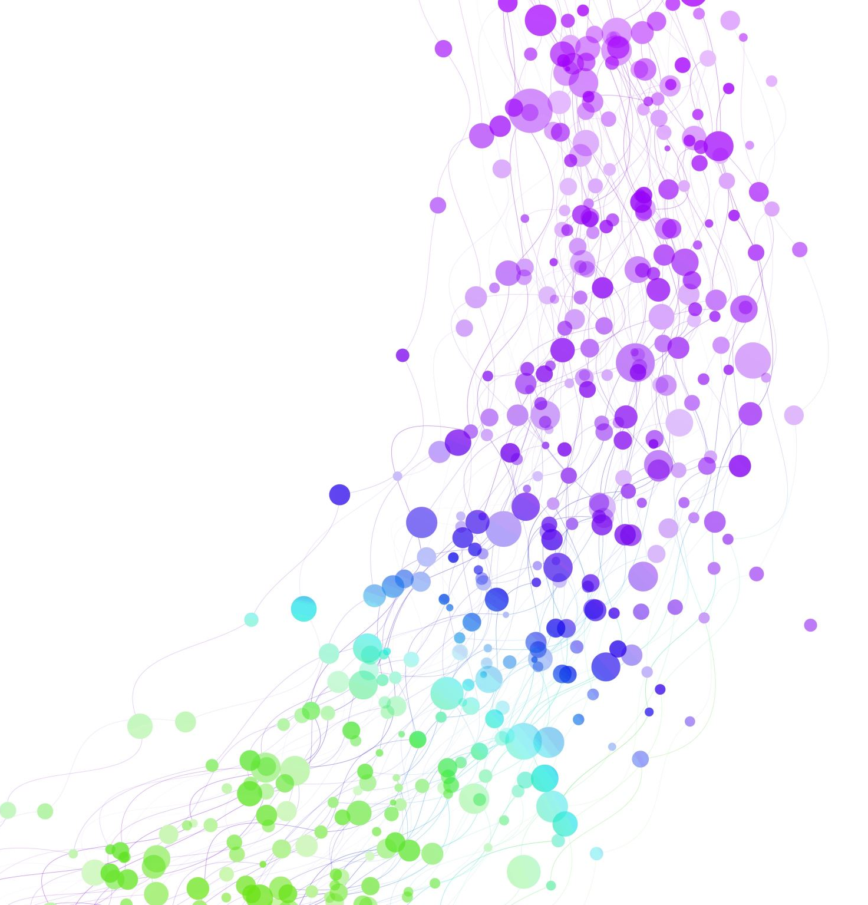
Predicting Liver Failure Risk with MIMIC-III Demo Data
Using Machine Learning to Analyze ICU Patient Data
Notes:
Hey there! This tutorial is about predicting liver failure risk in ICU patients using real data from the MIMIC-III demo dataset. Liver failure is serious and catching it early can save lives. We’ll use three CSV files and Jupyter Notebook to build a machine learning model step-by-step. Let’s dive in!

Slide 2
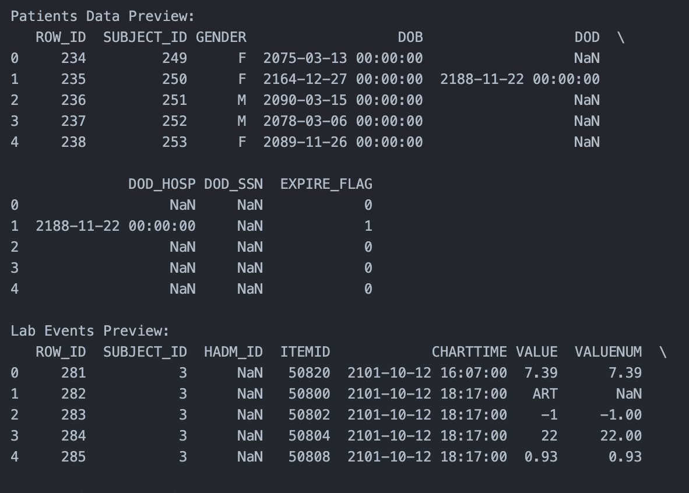
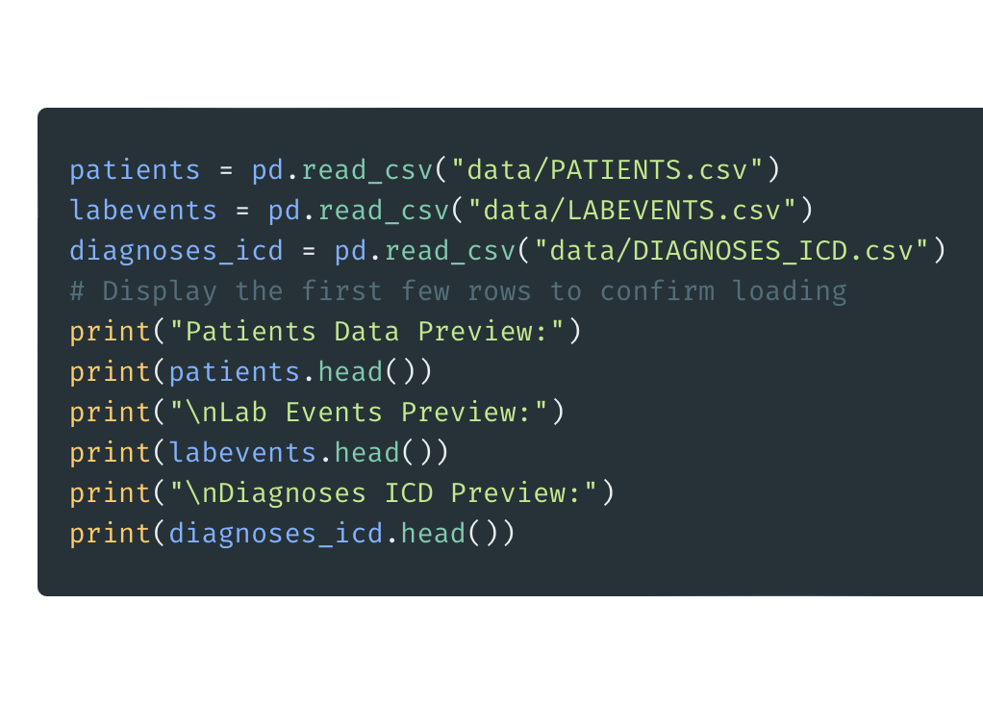
Step 1 - Load Data
Download files from PhysioNet
Load into Jupyter
Preview data to confirm
Notes:
First, we need our data. Go to PhysioNet, download the MIMIC-III demo files, and put them where Jupyter can find them. We load three files: PATIENTS gives us age and gender, LABEVENTS has lab tests like bilirubin and more, and DIAGNOSES_ICD lists diagnoses. Run the code to load them into Pandas and peek at the first few rows to make sure everything’s good.

Slide 3
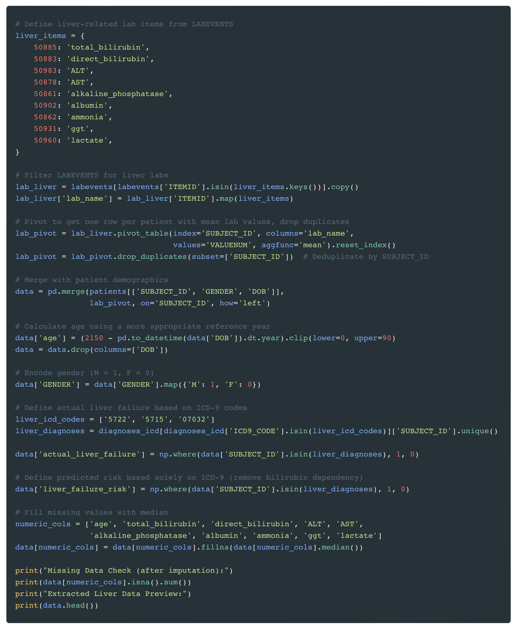
Step 2 - Extracting Liver-Related Data
Purpose: Prepare data for liver failure prediction
Define liver lab items (e.g., bilirubin, ALT, AST)
Filter and pivot LABEVENTS data
Merge with patient demographics (age, gender)
Define liver failure with ICD-9 codes
Handle missing values and deduplicate
Notes:
Let’s walk through Step 2, where we extract and prepare data for liver failure prediction. First, we define a dictionary called liver_items that maps ITEMIDs from LABEVENTS to liver-related labs like total bilirubin, ALT, and AST—these are key indicators of liver health. Next, we filter the LABEVENTS data to keep only these liver labs using isin(), and map the ITEMIDs to their names for clarity. Then, we pivot the data with pivot_table() to get one row per patient, using the mean of each lab value—this reshapes our data into a wide format. After that, we merge this with patient demographics from the PATIENTS file, including.Subject_ID, gender, and date of birth, using pd.merge(). We’ll later calculate age, encode gender, define liver failure with ICD-9 codes like 5722, fill missing values with medians, and deduplicate to ensure one row per patient. This gives us a clean dataset to work with for our prediction model!

Slide 4
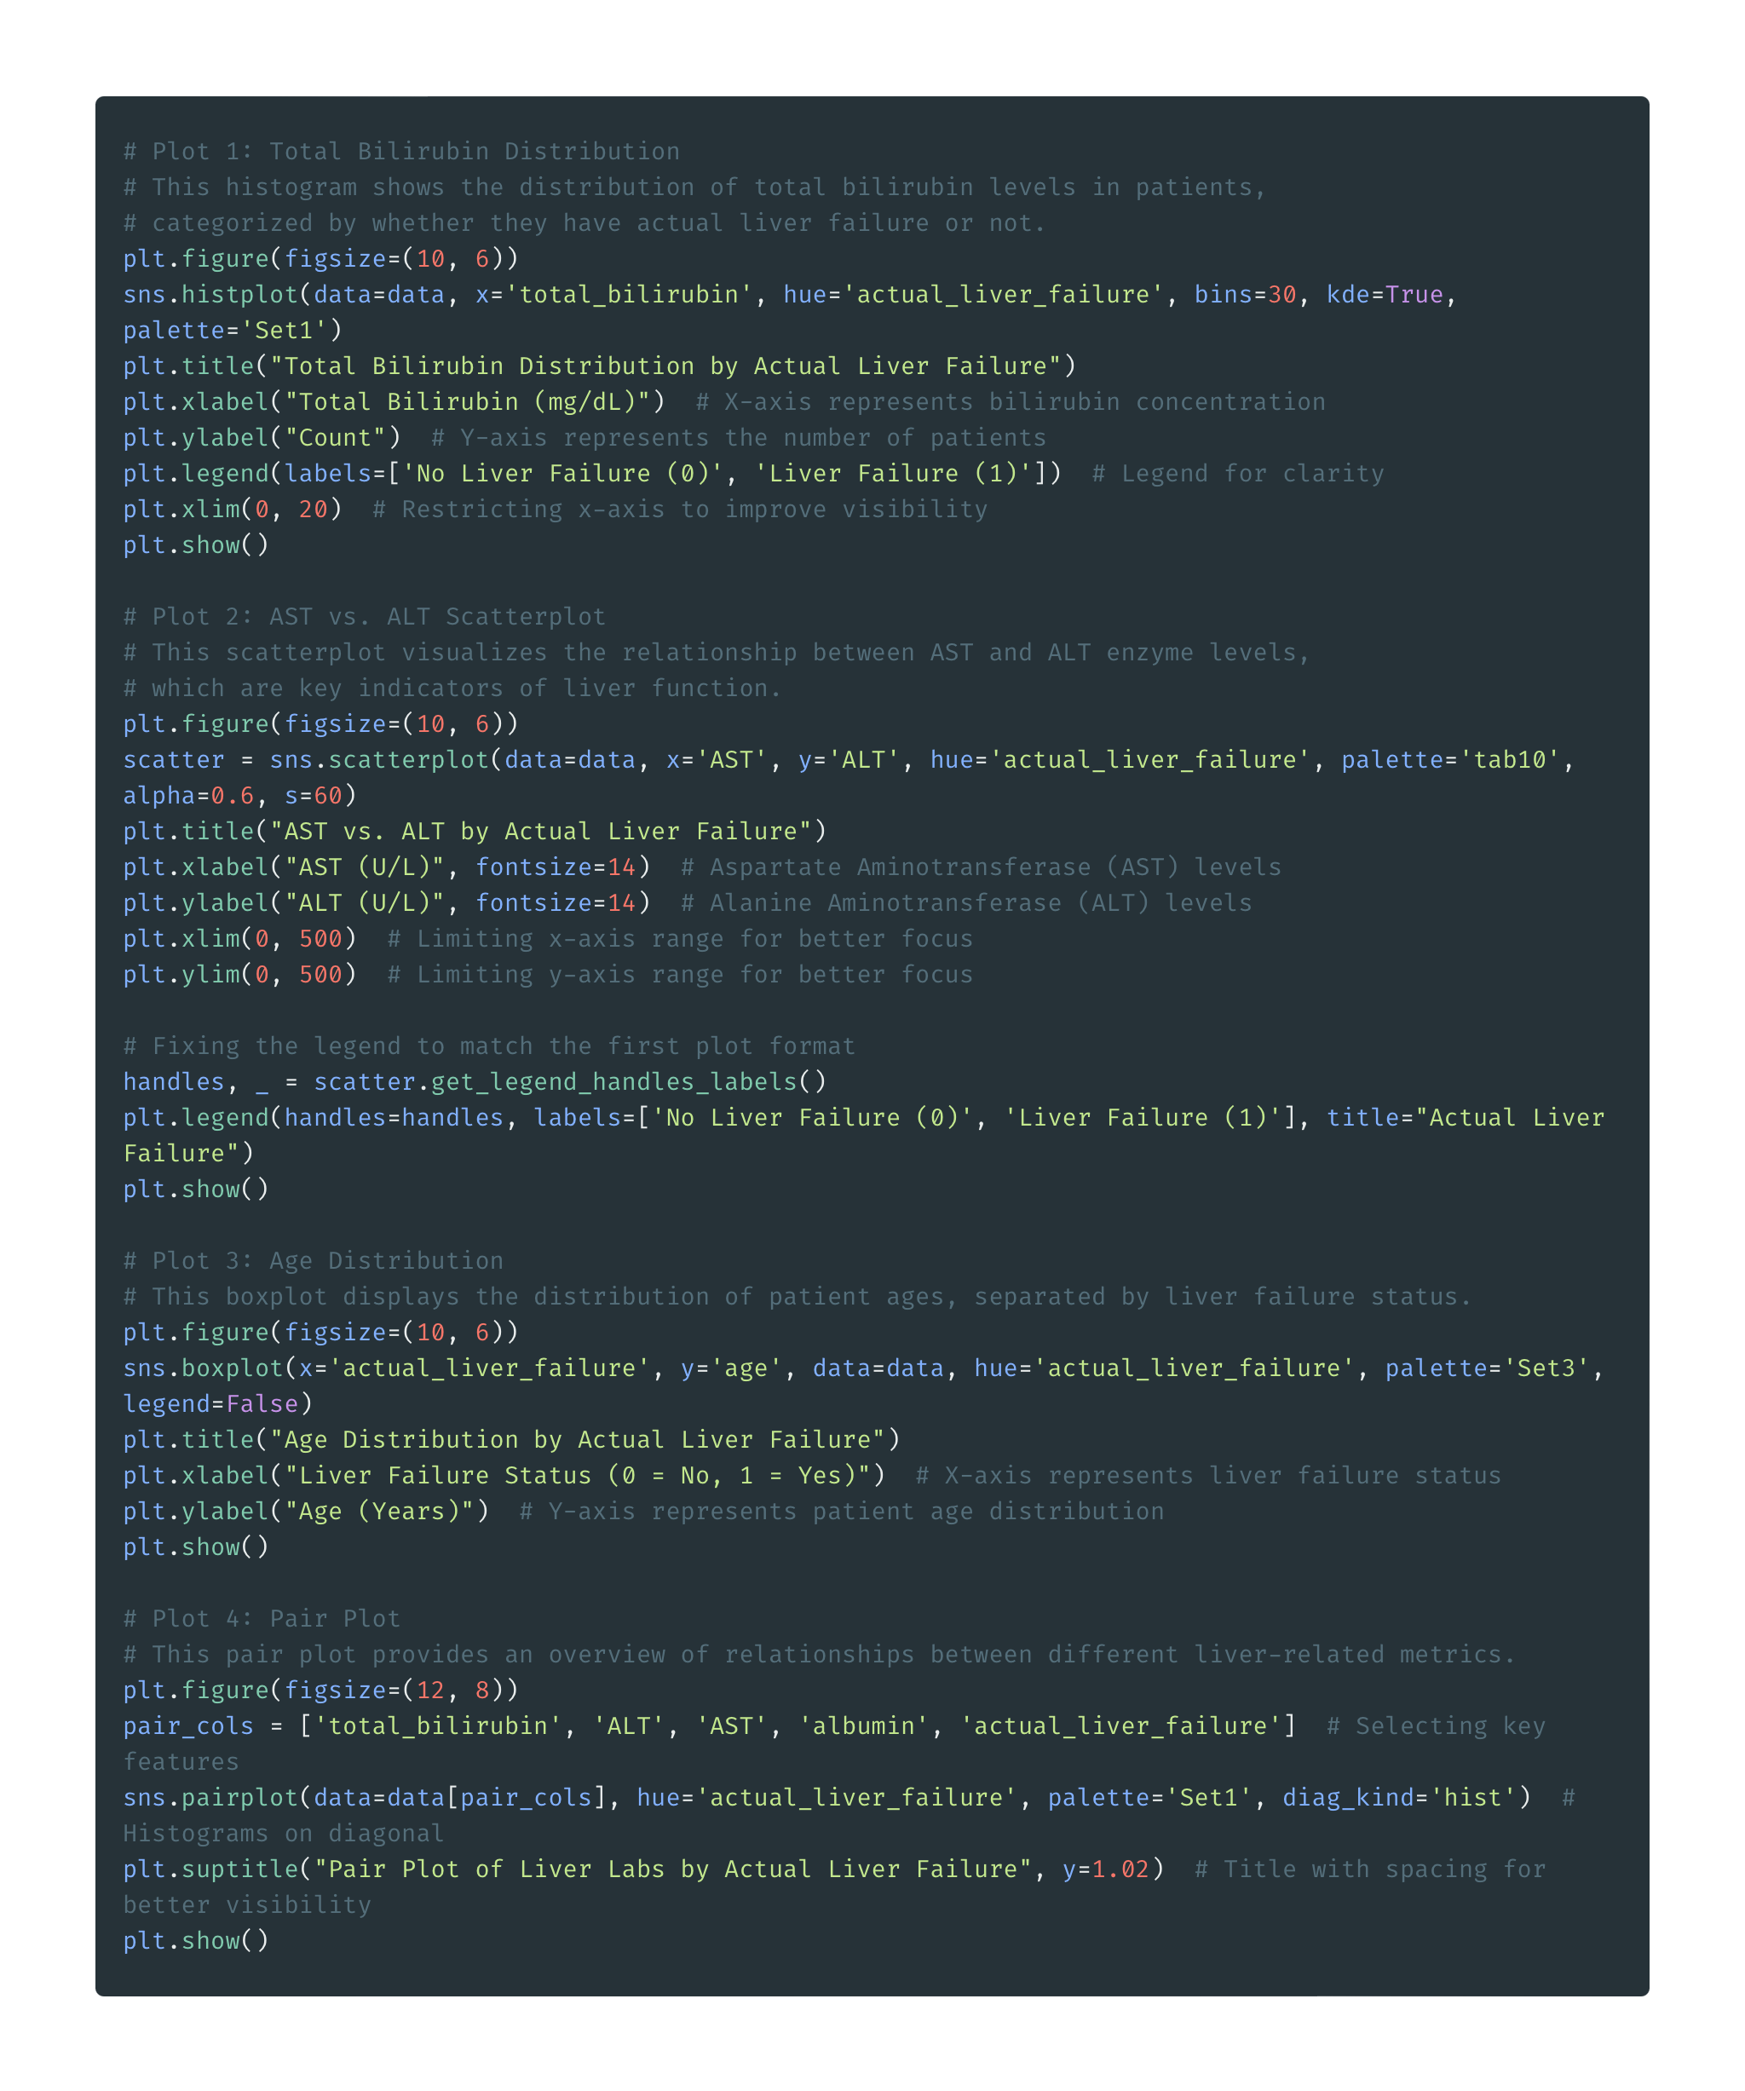
Step 3 - Understand with Plots
Total Bilirubin Distribution
Insight: Higher bilirubin in liver failure
AST vs. ALT Scatterplot
Insight: Elevated levels suggest liver damage
Age Boxplot
Insight: Age comparison
Pair Plot
Insight: Relationships between labs
Purpose: Spot patterns in liver failure indicators
Notes:
Let’s explore the data with plots to spot patterns. We’ll look at four visualizations: a bilirubin distribution to see how levels differ, an AST vs. ALT scatterplot to check for liver damage, an age boxplot to compare age distributions, and a pair plot to see relationships between key labs. These will help us understand what drives liver failure. Let’s dive into each one!

Slide 5
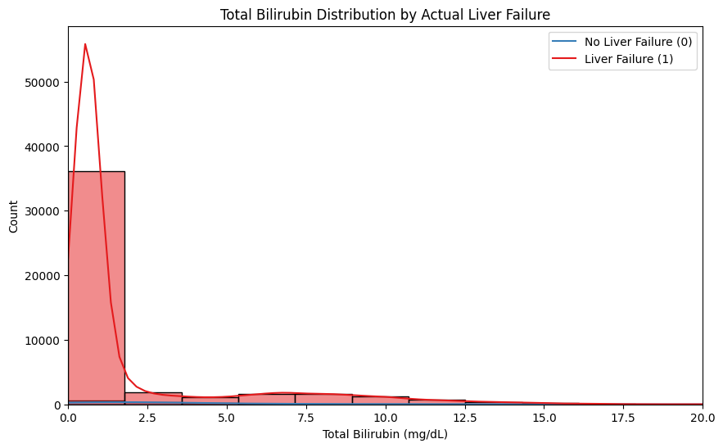
Plot 1 - Total Bilirubin Distribution by Actual Liver Failure
Liver failure patients have higher bilirubin
Peaks shift right for liver failure
Purpose: Identify bilirubin as a liver failure indicator
Notes:
Here’s our first plot: a histogram of total bilirubin levels, split by liver failure status. The x-axis shows bilirubin in mg/dL, and the y-axis shows the count of patients. Blue represents patients without liver failure, and red shows those with it. Notice how the red peak is shifted to the right—patients with liver failure tend to have higher bilirubin, often above 3 mg/dL, while most without failure are below that. The KDE lines smooth out the data, confirming this trend. This suggests bilirubin is a key indicator, which we’ll use in our model!"

Slide 6
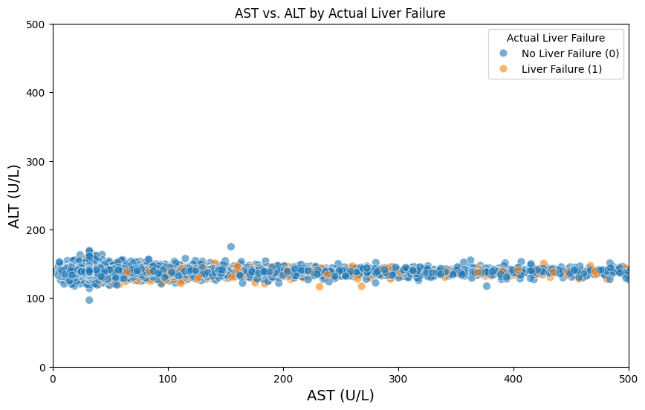
Plot 2 - AST vs. ALT by Actual Liver Failure
Elevated AST and ALT in liver failure
Liver failure clusters at higher values
Purpose: Explore liver enzyme correlation with failure
Notes:
Next, we have a scatterplot of AST vs. ALT, two liver enzymes. The x-axis is AST, and the y-axis is ALT, both in units per liter. Green dots are patients without liver failure, and orange dots are those with it. We’ve capped the axes at 500 to focus on typical values. See how the orange dots tend to cluster at higher levels—many liver failure patients have both AST and ALT above 100, while green dots are more spread out at lower values. The transparency helps with overlap. This tells us elevated enzymes are a sign of liver damage, which our model can use!

Slide 7
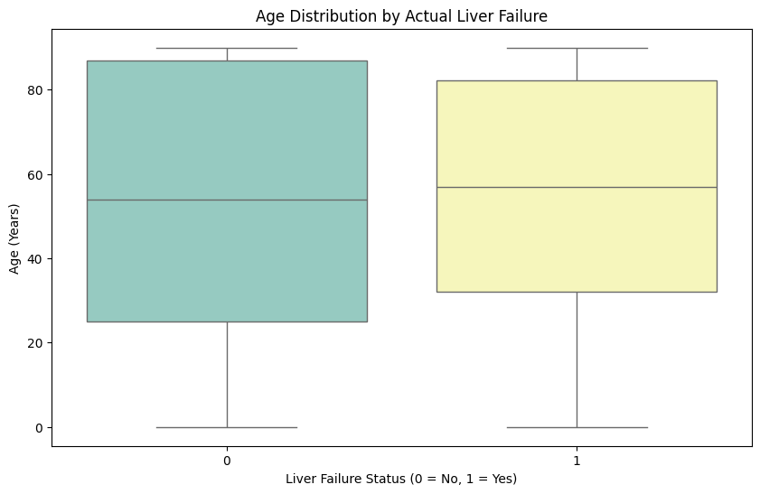
Plot 3 - Age Distribution by Actual Liver Failure
Older patients more likely to have liver failure
Higher median age for liver failure
Purpose: Assess age as a risk factor
Notes:
This boxplot looks at age distribution by liver failure status. The x-axis splits patients into no liver failure (0) and liver failure (1), and the y-axis shows age in years. Each box shows the median age as the middle line, with the box covering the 25th to 75th percentiles. Whiskers extend to the min and max, and dots are outliers. Notice the median age for liver failure patients is higher—maybe around 60—compared to those without, around 50. This suggests older age might be a risk factor, which our model can pick up on!

Slide 8
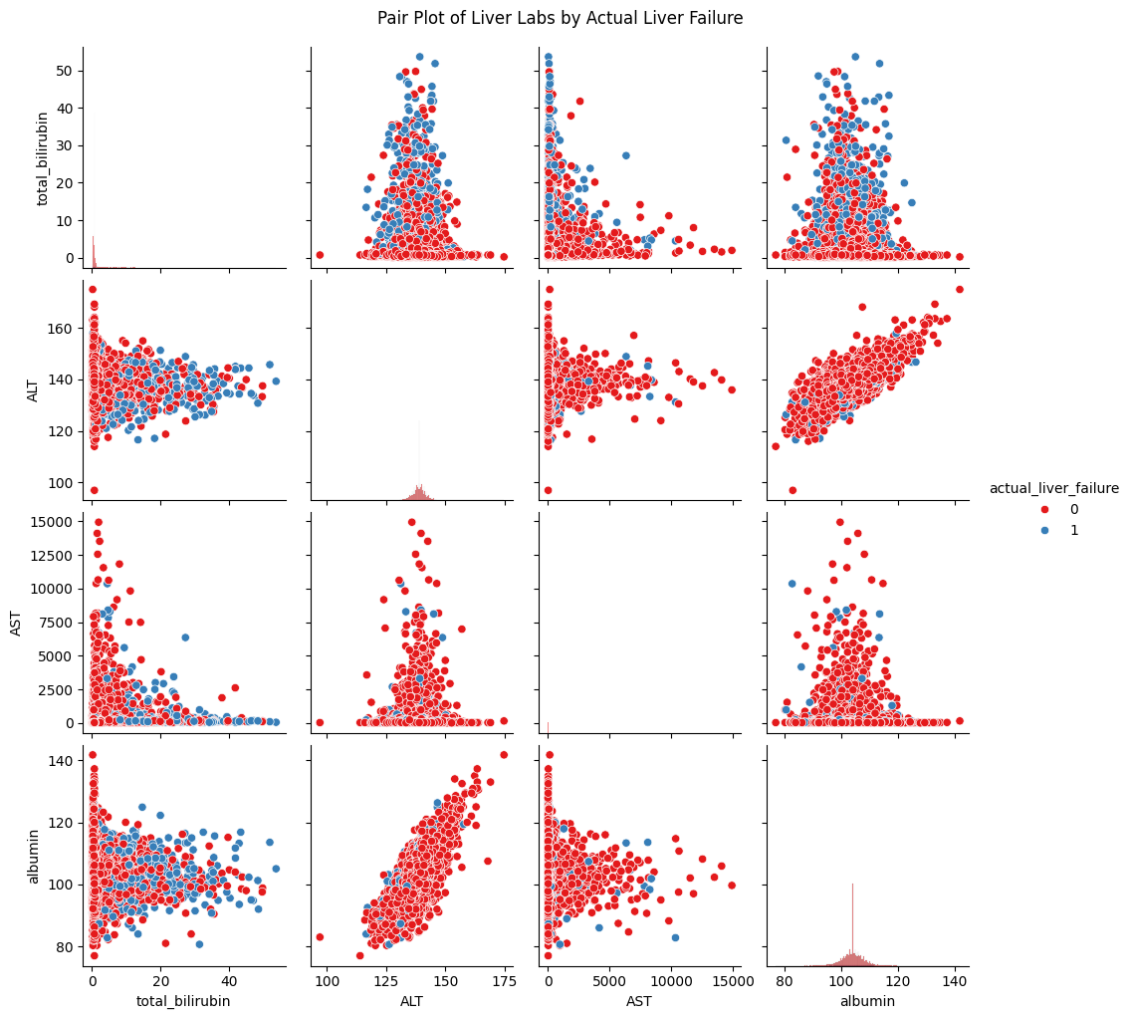
Plot 4 - Pair Plot of Liver Labs by Actual Liver Failure
Relationships between labs and liver failure
Higher bilirubin, ALT, AST, lower albumin in failure
Purpose: Explore correlations across features
Notes:
Here’s our pair plot, which gives a multi-dimensional view of four key labs: total_bilirubin, ALT, AST, and albumin. Blue points are no liver failure, and red are liver failure. The diagonal shows histograms for each feature—see how bilirubin peaks higher for red, and albumin is lower. The off-diagonal scatterplots show pairwise relationships—like high bilirubin often pairs with high AST in liver failure cases. This plot helps us see correlations and patterns, confirming that these labs are related to liver failure. It’s a great way to spot trends before modeling!

Slide 9
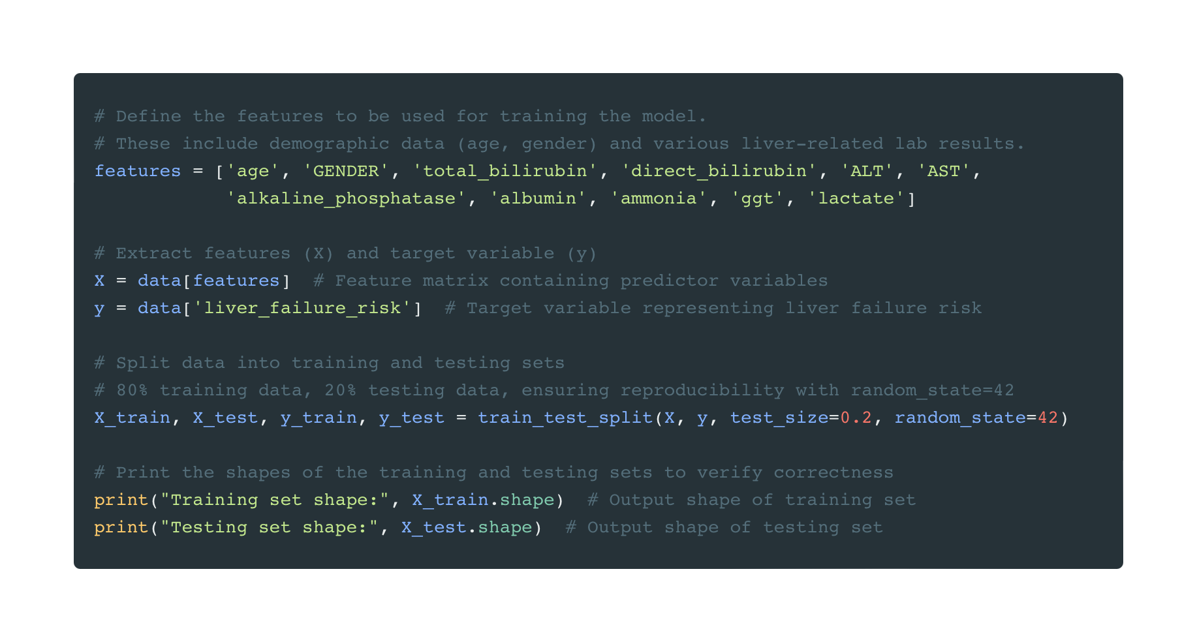
Step 4 - Prepare Data for Machine Learning
Purpose: Set up data for training the model
Define features (age, gender, liver labs)
Extract features (X) and target (y)
Split data: 80% training, 20% testing
Verify split with shapes
Notes:
In Step 4, we prepare our data for machine learning. First, we define our features—these are the variables we’ll use to predict liver failure risk, like age, gender, and liver labs such as bilirubin and ALT. We store these in a list called features. Next, we extract our feature matrix X by selecting these columns from our dataset, and our target variable y, which is the liver failure risk we defined earlier. Then, we split the data into 80% for training and 20% for testing using train_test_split()—this lets us train our model on most of the data and test it on the rest to see how well it performs. The random_state=42 ensures our split is reproducible. We can check the shapes of the training and testing sets to confirm the split worked correctly, which we’d see in the output if we printed them.

Slide 10
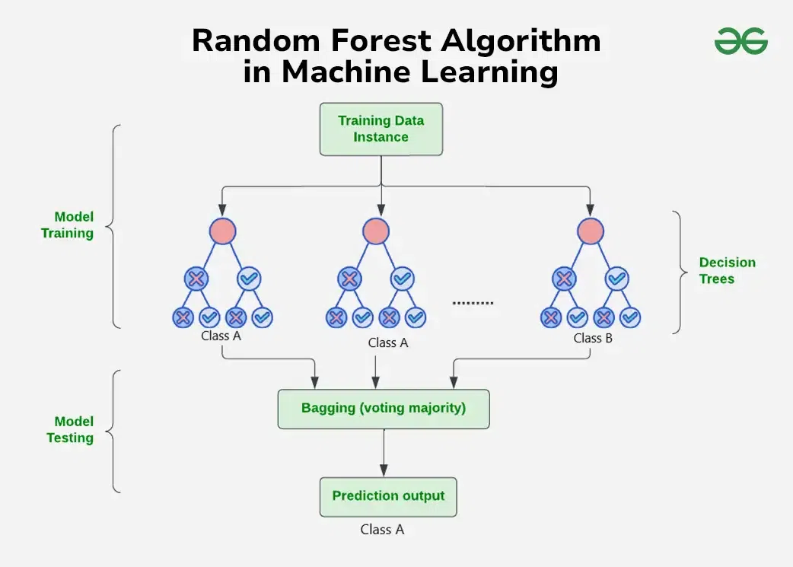
Understanding Random Forest for Beginners
What is Random Forest?
A team of decision trees working together
Analogy:
Like asking 100 friends to vote on a decision
How it Works:
Each tree makes a prediction
Final result is the majority vote
Why Use It?
Reduces errors, handles complex data well
GeeksforGeeks: https://www.geeksforgeeks.org/random-forest-algorithm-in-machine-learning/
Notes:
Let’s break down Random Forest for beginners. Random Forest is a machine learning model that’s like a team of decision trees working together. Think of it as asking 100 friends to vote on a decision—say, whether a patient is at risk for liver failure. Each friend (or tree) looks at the data—like age or bilirubin levels—and makes a prediction. Then, they all vote, and the majority wins! This teamwork reduces errors because one tree might be wrong, but the group is usually more accurate. Random Forest is great for our project because it handles complex data well and is easy to interpret, especially for beginners. The graph here, from GeeksforGeeks, illustrates this process: it shows multiple decision trees taking subsets of the data, making predictions, and then combining their votes to produce a final result. You can see how the trees work together to improve accuracy!

Slide 11
Understanding Machine Learning
What is ML?
Computers learn patterns from data to make predictions
How it Works:
Uses algorithms (e.g., Random Forest) to analyze features
Trains on data to improve accuracy
Relevance:
Helps predict liver failure risk using ICU data
No need for explicit programming of rules
Background:
Based on statistical models and decision trees
Widely used in healthcare for diagnostics
Notes:
Now that we know about Random Forest, let’s zoom out and understand machine learning (ML) in general. ML is when computers learn patterns from data to make predictions, like guessing if a patient has liver failure risk. It uses algorithms like Random Forest, which analyzes features like bilirubin levels and trains on data to get better. This is perfect for our project because it lets us predict risk without manually coding rules. ML is grounded in statistics and decision trees, and it’s widely used in healthcare to support diagnostics—making it a powerful tool for us here!

Slide 12
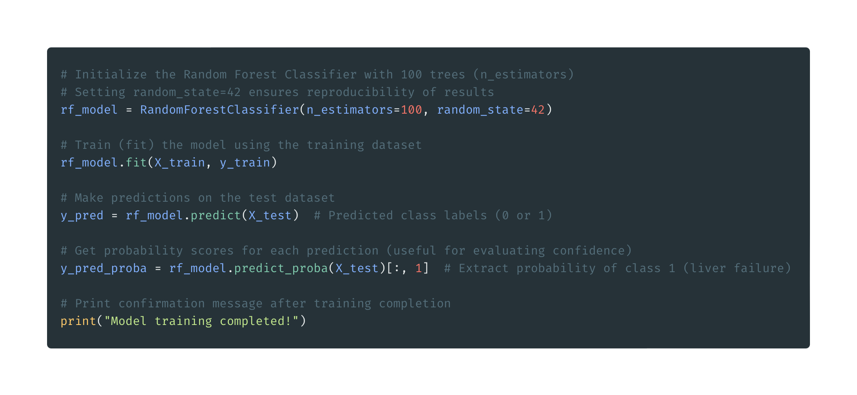
Step 5 - Apply the Random Forest Model
Purpose: Train and predict with Random Forest
Initialize model with 100 trees
Train model on training data
Predict on test data (labels and probabilities)
Confirm training completion
Notes:
Now we apply our Random Forest model in Step 5. First, we initialize the model with RandomForestClassifier(), setting it to use 100 trees—this is the n_estimators parameter, and random_state=42 ensures our results are reproducible. Next, we train the model on our training data using fit()—this is where the model learns patterns, like how high bilirubin might indicate liver failure risk. Then, we use predict() to get predictions on our test data—these are labels, 0 for no risk or 1 for risk. We also use predict_proba() to get probabilities, which tell us how confident the model is—like a 90% chance of risk. Finally, we print a message to confirm the training is done, so we know it’s ready for evaluation in the next step!

Slide 13
Step 6 - Understanding the ML Model and Plots
Model: 100 decision trees voting on outcome
Strengths: Reduces overfitting, ranks importance
Plots:
Sorted Feature Importance
Normalized Confusion Matrix
Precision-Recall Curve
Predicted Probability Distribution
t-SNE Plot
2D Density Plot
Purpose: Learn model behavior
Notes:
Now that we’ve trained our Random Forest model and made predictions, let’s understand how it works and evaluate its performance. Random Forest is a team of 100 decision trees that vote on the outcome—whether a patient is at risk or not. It’s great because it reduces overfitting and can rank which features, like bilirubin, are most important. We’ll use six plots to analyze our model: a feature importance chart to see what drives predictions, a confusion matrix to check accuracy, a Precision-Recall curve for imbalanced data, a probability distribution to see class separation, a t-SNE plot to visualize data clusters, and a 2D density plot to explore feature interactions. These will help us understand our model’s behavior!

Slide 14
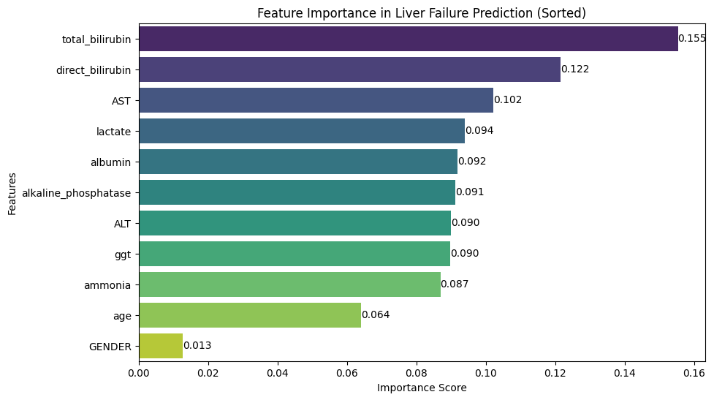
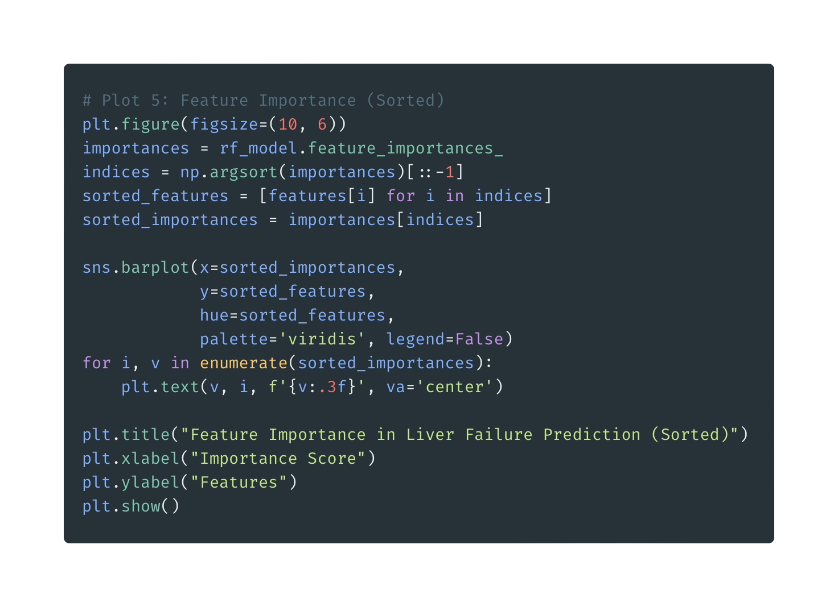
Plot 5 - Sorted Feature Importance in Liver Failure Prediction
Total_bilirubin most important
Other labs also contribute
Purpose: Identify key prediction drivers
Notes:
Here’s our first results plot: a sorted feature importance chart. The x-axis shows the importance score from 0 to 1, and the y-axis lists our features. The bars are sorted, so we see total_bilirubin at the top with a score of 0.665—meaning it’s the biggest driver of our predictions. Other features like direct_bilirubin, AST, and ggt also matter but less so. The numerical labels give exact values, making it clear how much each feature contributes. This aligns with medical knowledge: high bilirubin is a key sign of liver failure, so our model is focusing on the right things!

Slide 15
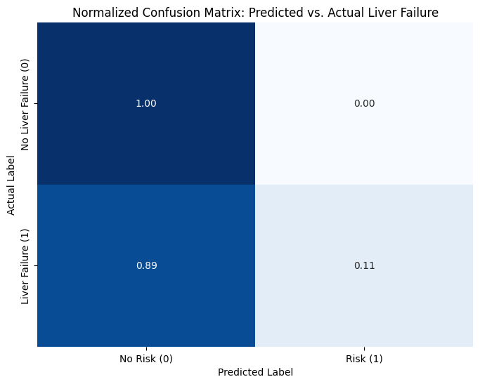
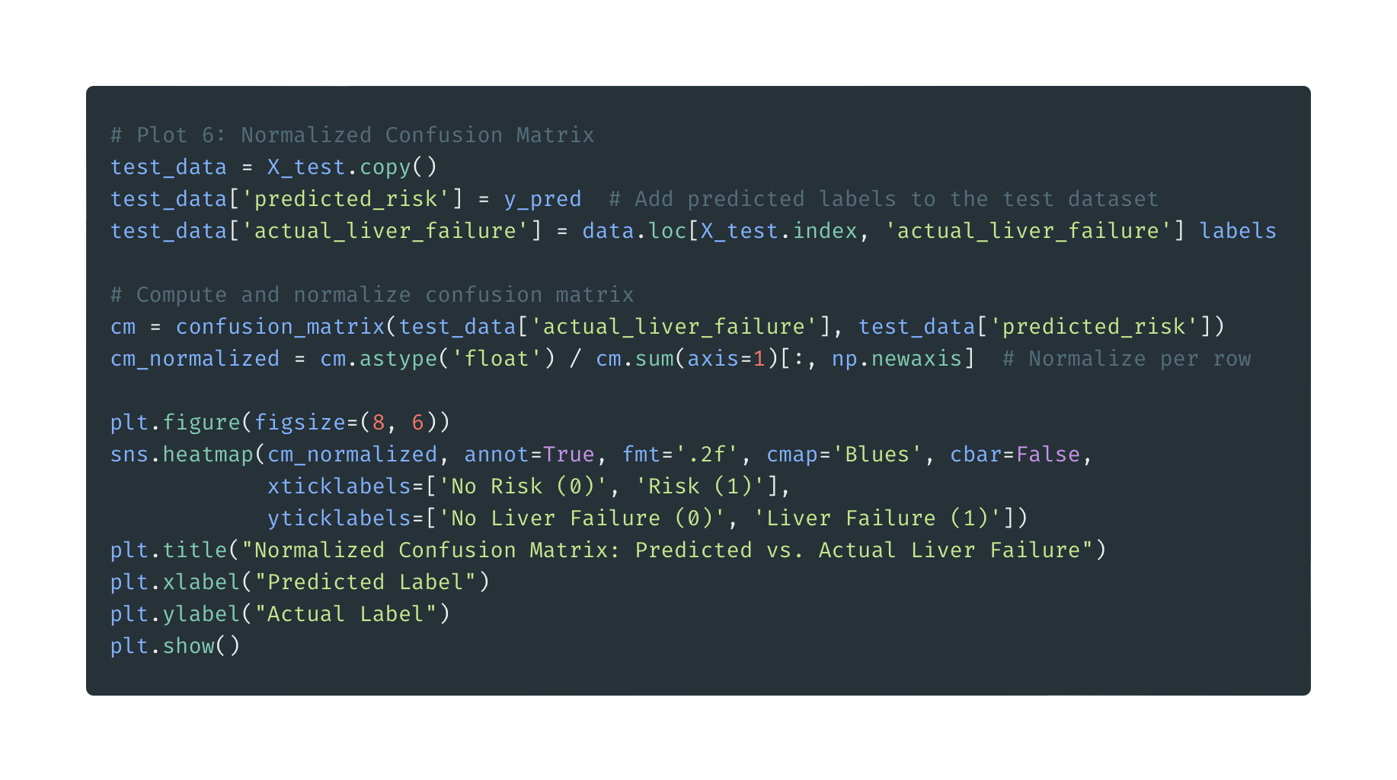
Plot 6 - Normalized Confusion Matrix: Predicted vs. Actual Liver Failure
Insight: Good at predicting no risk
Insight: 47% of liver failure cases correct
Purpose: Evaluate class prediction accuracy
Notes:
This is our normalized confusion matrix, showing how well our predictions match reality. Rows are actual liver failure status—0 for no, 1 for yes—and columns are predicted risk. The values are proportions, so 0.84 in the top-left means 84% of patients without liver failure were correctly predicted as no risk. But the bottom-right shows only 47% of liver failure cases were correctly predicted as at risk—meaning we miss over half. The darker blue colors highlight higher proportions. Since liver failure cases are rare, this imbalance makes it harder for the model, and we’ll see this in other plots too!

Slide 16
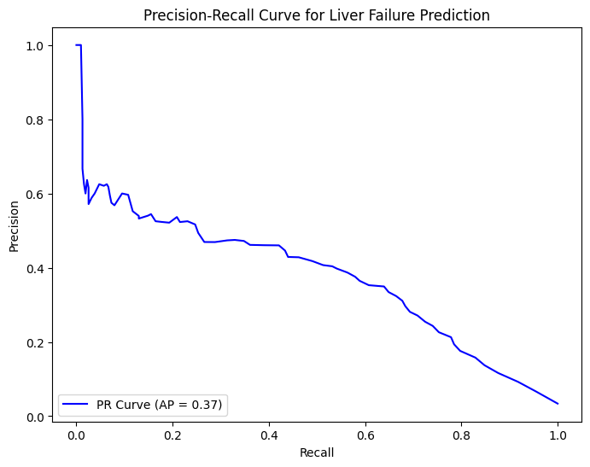
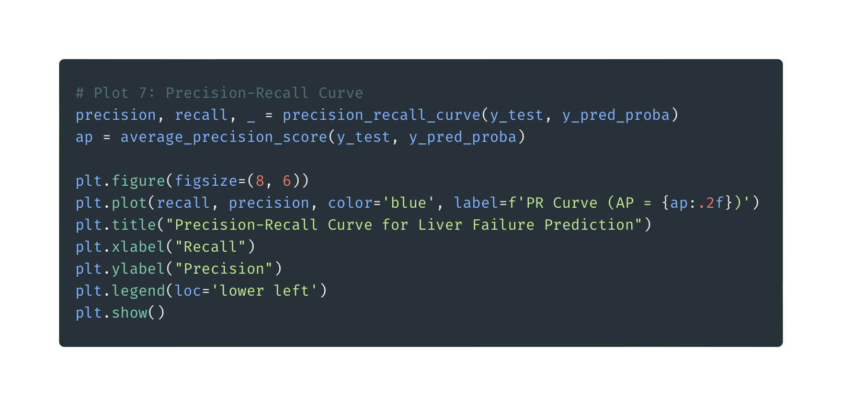
Plot 7 - Precision-Recall Curve for Liver Failure Prediction
High AP score shows good balance
Trade-off between recall and precision
Purpose: Assess performance on imbalanced data
Notes:
ext, we have the Precision-Recall curve, which is great for imbalanced data like ours where liver failure is rare. The x-axis is recall—how many actual liver failure cases we catch—and the y-axis is precision—how many of our predicted risks are correct. The blue line shows the trade-off: as recall increases, precision might drop. The Average Precision score, say 0.75, summarizes this curve—a higher AP means we’re doing well at balancing both. This plot tells us how well we’re identifying liver failure cases without too many false positives, which is critical in a medical context!

Slide 17
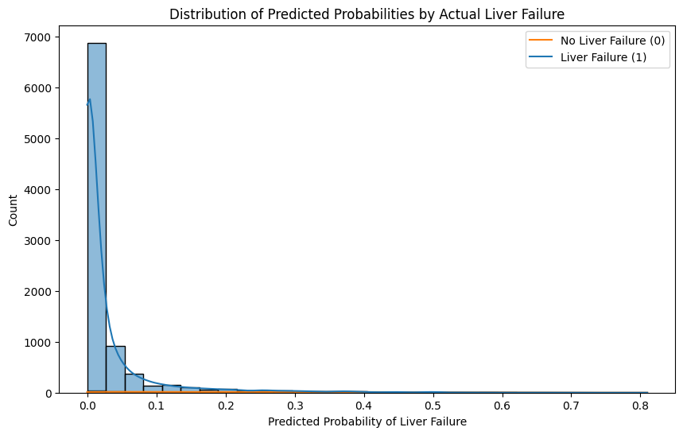
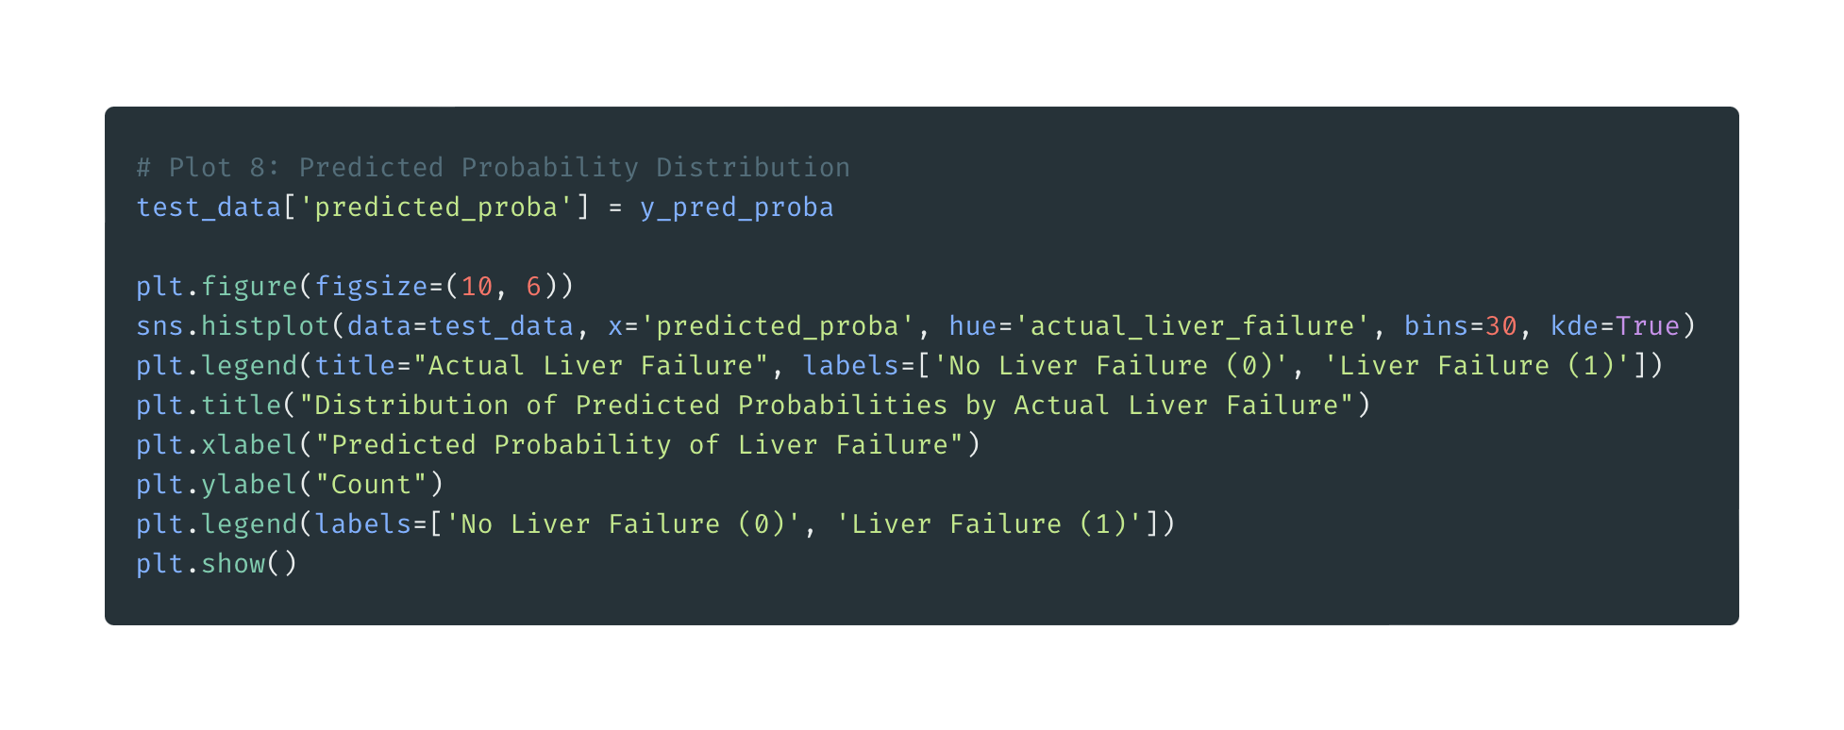
Plot 8 - Distribution of Predicted Probabilities by Actual Liver Failure
Good separation between classes
Realistic counts after deduplication
Purpose: Check confident class separation
Notes:
This plot shows the distribution of predicted probabilities, split by actual liver failure status. The x-axis is the predicted probability of liver failure from 0 to 1, and the y-axis is the count of patients. Blue is no liver failure, and red is liver failure. After deduplication, the counts are realistic—around 20 patients in our test set. See the separation: most blue cases are near 0, meaning the model is confident they’re not at risk, and red cases are near 1, showing confidence in liver failure predictions. The KDE lines confirm this trend. This separation suggests our model is doing a good job distinguishing classes!

Slide 18
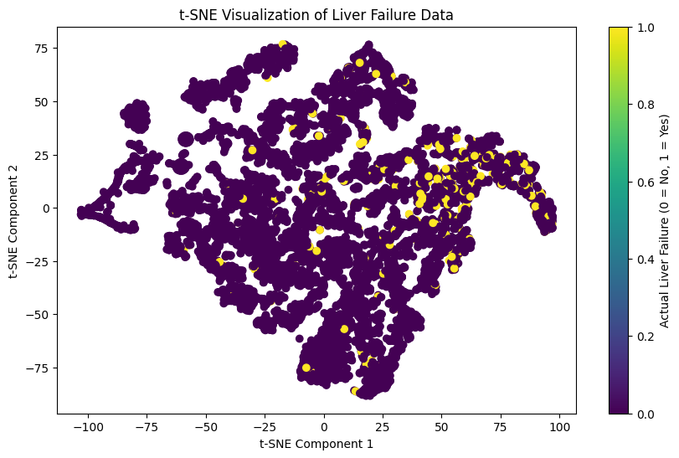
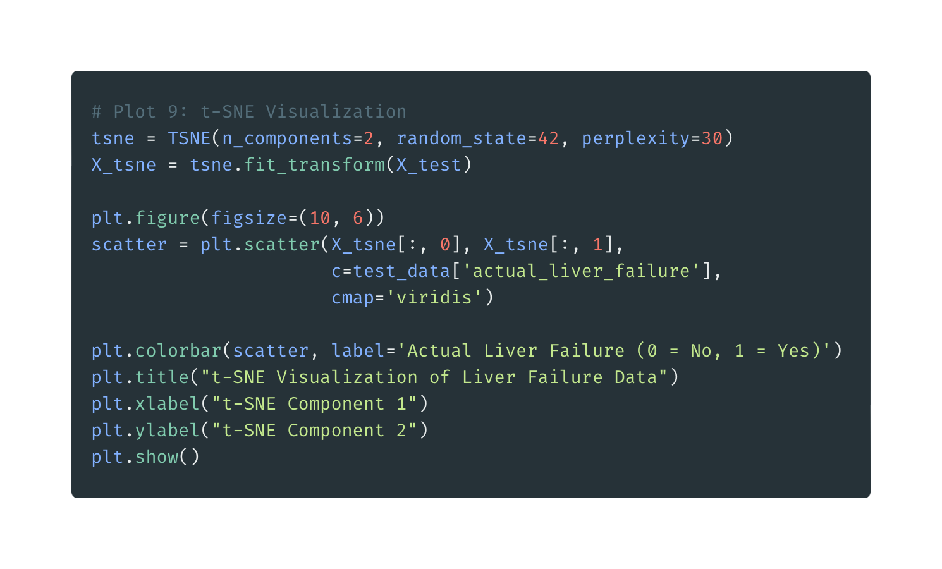
Plot 9 - t-SNE Visualization of Liver Failure Data
Shows class separation
Distinct clusters suggest discriminative features
Purpose: Assess class separation in 2D
Notes:
Here’s our t-SNE plot, which reduces our 11 features to 2D for visualization. The x-axis and y-axis are t-SNE components—think of them as new axes that capture the data’s structure. Points are colored by actual liver failure: 0 for no failure, 1 for failure, with a colorbar from yellow to purple. We used a perplexity of 30 to balance local and global structure. If we see distinct clusters—like yellow points on one side and purple on the other—it means our features naturally separate the classes, which is great for our model. Overlap would suggest it’s harder to distinguish, guiding us to improve features or the model!

Slide 19
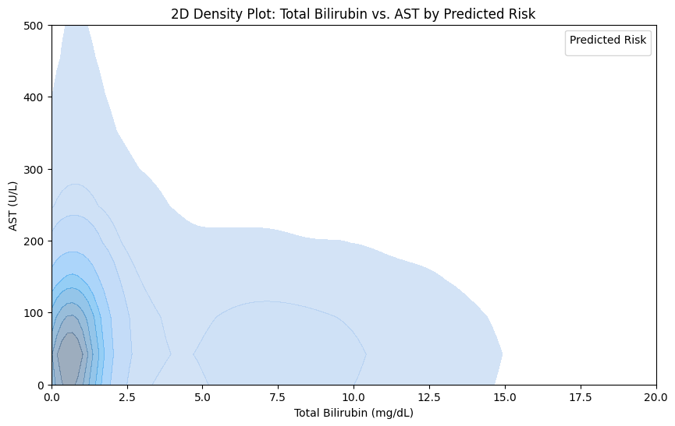
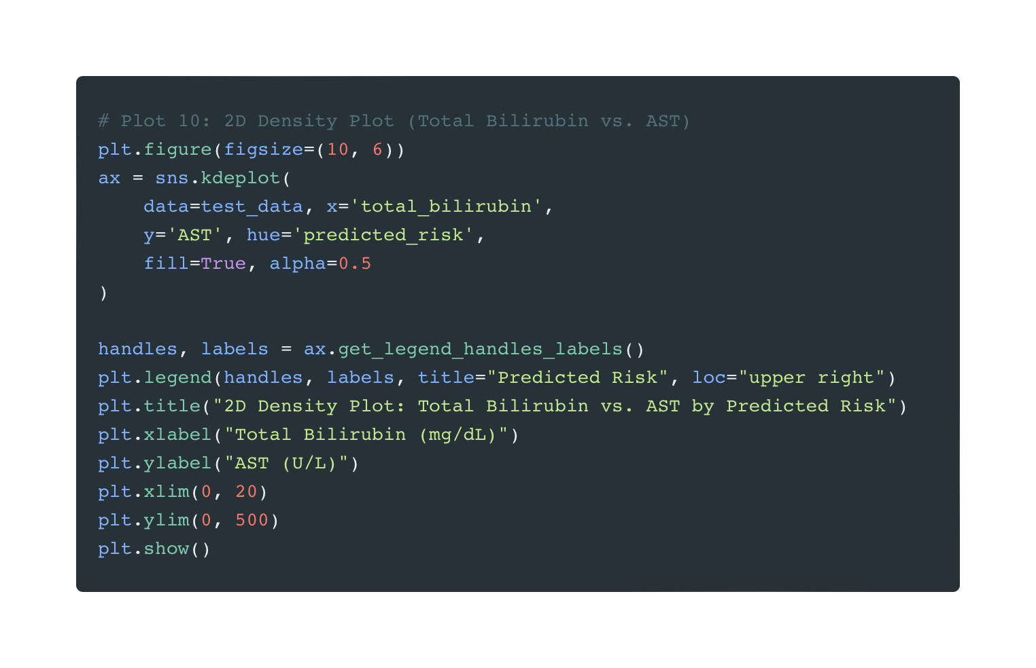
Plot 10 - 2D Density Plot: Total Bilirubin vs. AST by Predicted Risk
High-risk at higher bilirubin and AST
Interaction of elevated labs increases risk
Purpose: Explore feature interactions
Notes:
Our final plot is a 2D density plot of total_bilirubin vs. AST, colored by predicted risk. The x-axis is bilirubin in mg/dL, capped at 20, and the y-axis is AST in units per liter, capped at 500. Green areas show where the model predicts no risk, and orange shows predicted risk. The filled contours give a smooth view of density—darker areas mean more patients. Notice how orange regions cluster where both bilirubin and AST are high, like above 5 mg/dL and 100 U/L. This shows the model predicts risk when both labs are elevated, highlighting their interaction as key drivers of liver failure risk!

Slide 20
Conclusion and Next Steps
Loaded MIMIC-III demo data
Visualized liver features
Built and evaluated Random Forest model
Compared predictions to actual cases
Takeaway: ML can spot liver failure risk
Next Steps:
Investigate missing data
Add time-series analysis
Try neural network
Share notebook
Notes:
We’ve done it! We loaded ICU data, pulled out a ton of liver clues, visualized patterns with plots like t-SNE, and built a Random Forest model to predict liver failure risk. It matches actual cases well, though some data like albumin is missing. This shows how ML can help in healthcare. Next steps? Dig into missing data, look at lab trends over time, or try a neural network.

